Slide 1

Assignment#4 Sentiment Analysis
Submitted by
Sangeeta Gollapalli (200521939)

Slide 2

Project Name: Sentiment Analysis on the Amazon reviews dataset
This dataset containing Amazon Product Data includes product categories and various metadata. The product with the most comments in the electronics category has user ratings and comments. In this way, we expect to perform sentiment analysis with specific methods.

Slide 3

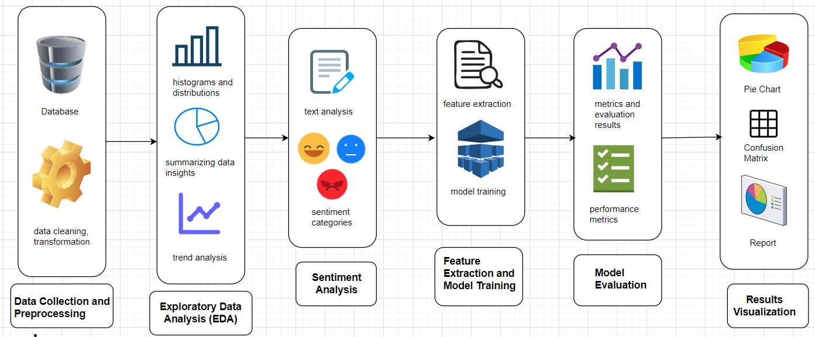
Project architecture

Slide 4
Libraries Used
Data Preparation:
Utilized pandas for data manipulation and numpy for numerical operations. Cleaned and preprocessed the dataset.
Text Feature Extraction:
Employed CountVectorizer and TfidfVectorizer to convert text data into numerical features for analysis and modeling.
Sentiment Analysis:
Applied SentimentIntensityAnalyzer from nltk to determine sentiment scores of text, classifying reviews into positive, negative, or neutral.
Model Building:
Implemented MultinomialNB classifier using sklearn for text classification based on extracted features.
Model Evaluation:
Evaluated model performance with accuracy_score, classification_report, and confusion_matrix to assess accuracy and error metrics.
Visualization:
Generated WordCloud visualizations to represent frequently occurring terms in positive and negative reviews, and used matplotlib and seaborn for additional data visualization.

Slide 5
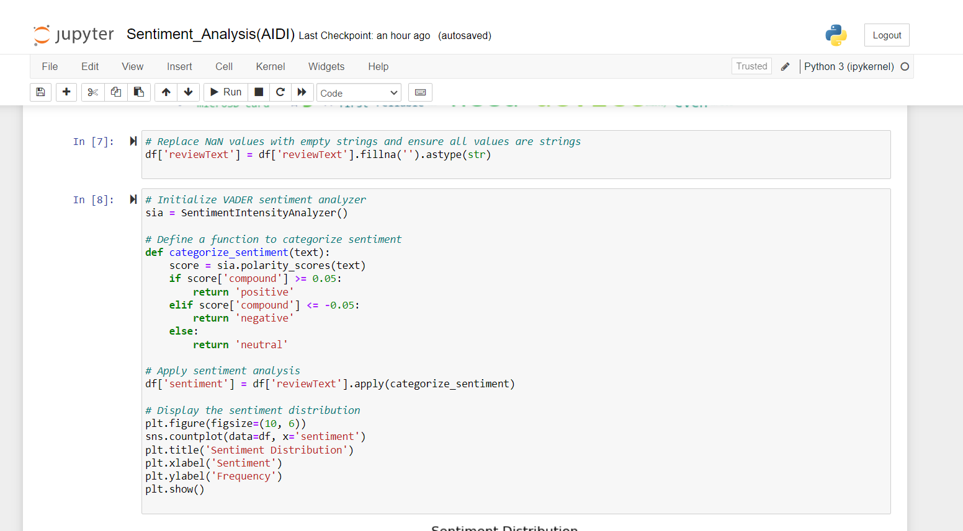
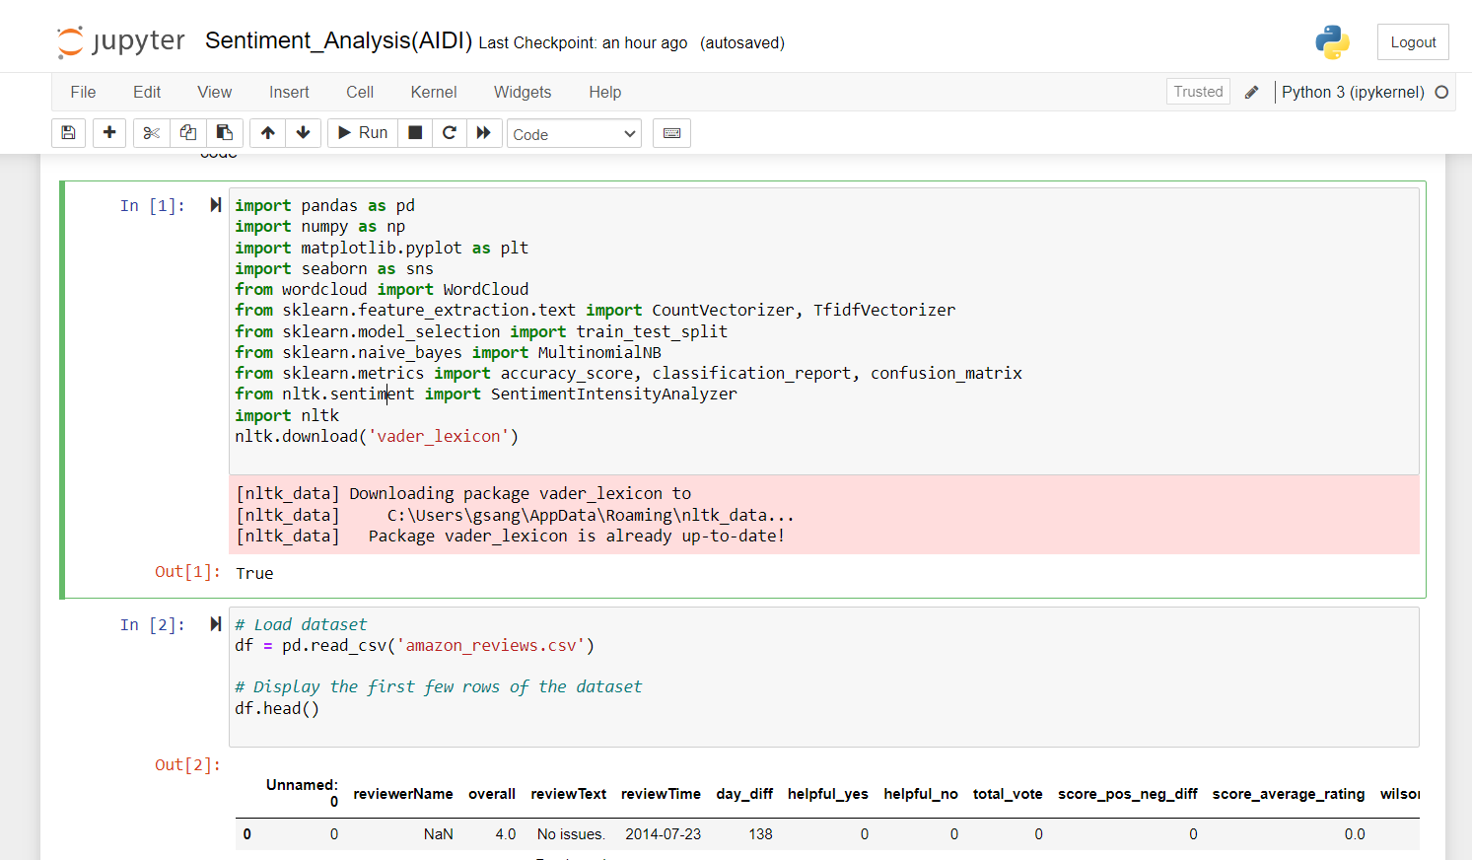
Project screenshots

Slide 6
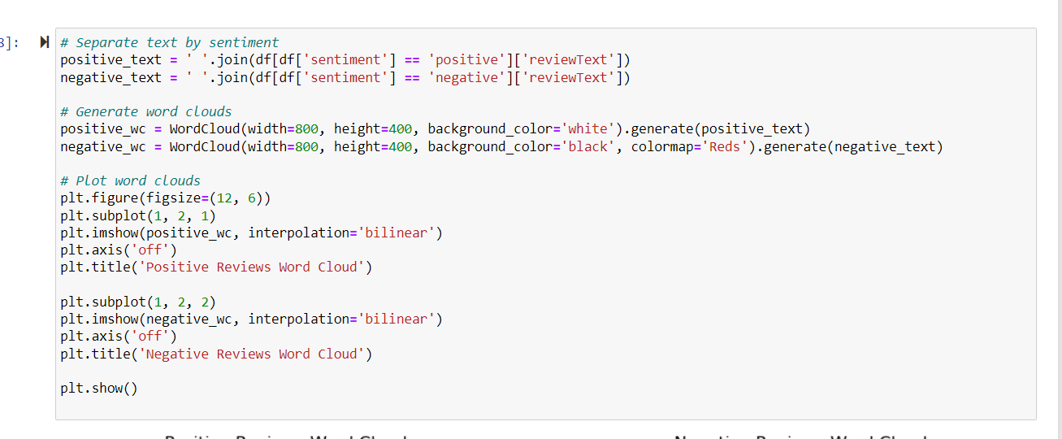
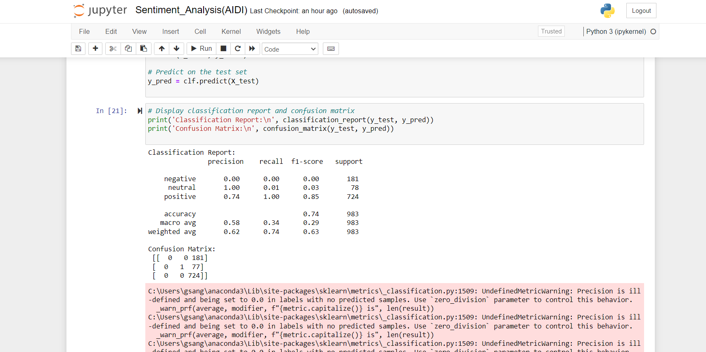

Slide 7
Code explanation – Data Preparation
Data Preparation:
Libraries: Imported essential libraries such as pandas, numpy, matplotlib, seaborn, wordcloud, sklearn, and nltk.
Data Loading: Loaded the dataset amazon_reviews.csv using pandas.
Basic Info: Checked the dataset’s basic information, missing values, and summary statistics.
Initial Exploratory Analysis:
Distribution of Ratings: Used seaborn to plot the distribution of ratings with a histogram, showing the frequency of different rating values.
Word Cloud: Generated a word cloud from review text to visualize frequently occurring words. Used WordCloud for a graphical representation.
Sentiment Analysis Preparation:
Text Cleaning: Replaced missing values in review text with empty strings and ensured all values are strings.
Sentiment Analysis: Applied VADER sentiment analysis from nltk to classify reviews into positive, negative, or neutral sentiments.

Slide 8
Code explanation – Model Building and Evaluation
Feature Extraction and Model Training:
Text Vectorization: Used TfidfVectorizer to convert review text into numerical features for the model.
Model Training: Split data into training and test sets using train_test_split. Trained a Naive Bayes classifier (MultinomialNB) on the training data.
Model Evaluation:
Performance Metrics: Evaluated model performance with accuracy_score, classification_report, and confusion_matrix to assess precision, recall, and F1-score.
Confusion Matrix: Displayed how predictions compared to actual values, highlighting model performance on different sentiment classes.
Saving Results:
Sentiment Labels: Applied sentiment analysis and saved the updated dataset with sentiment labels to a new CSV file amazon_reviews_with_sentiment.csv.

Slide 9
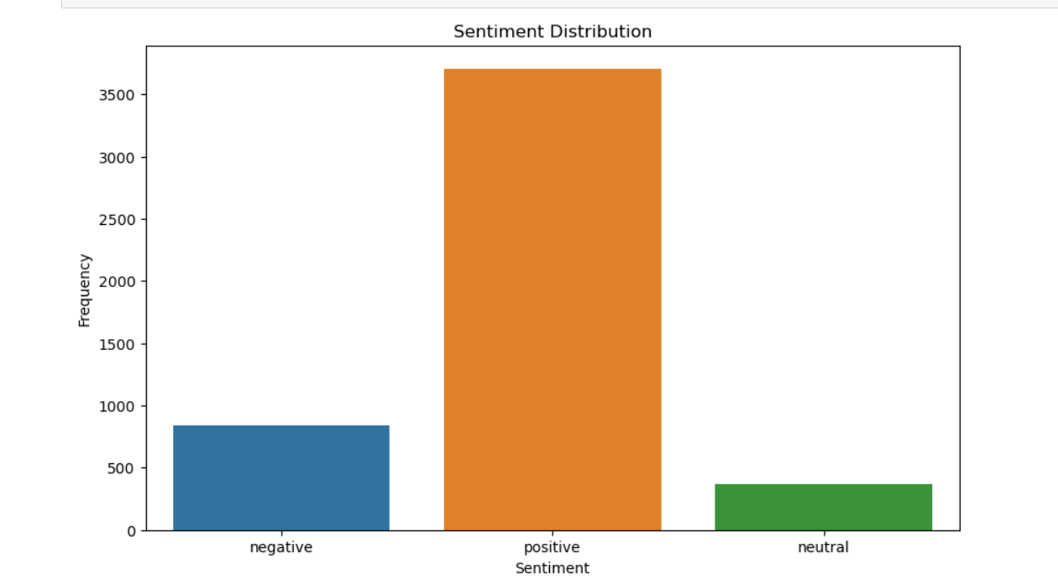
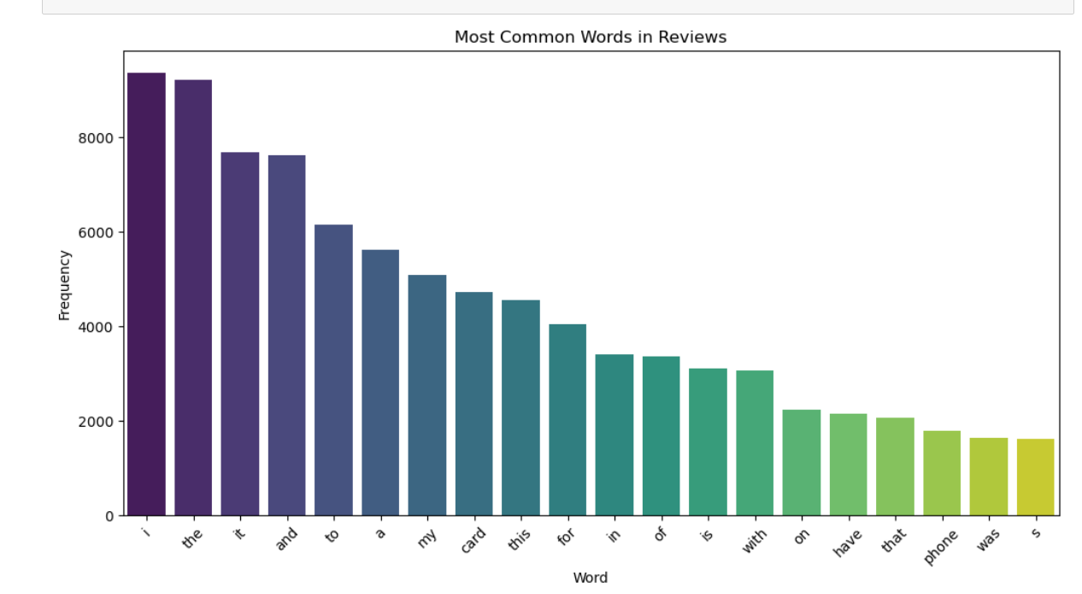

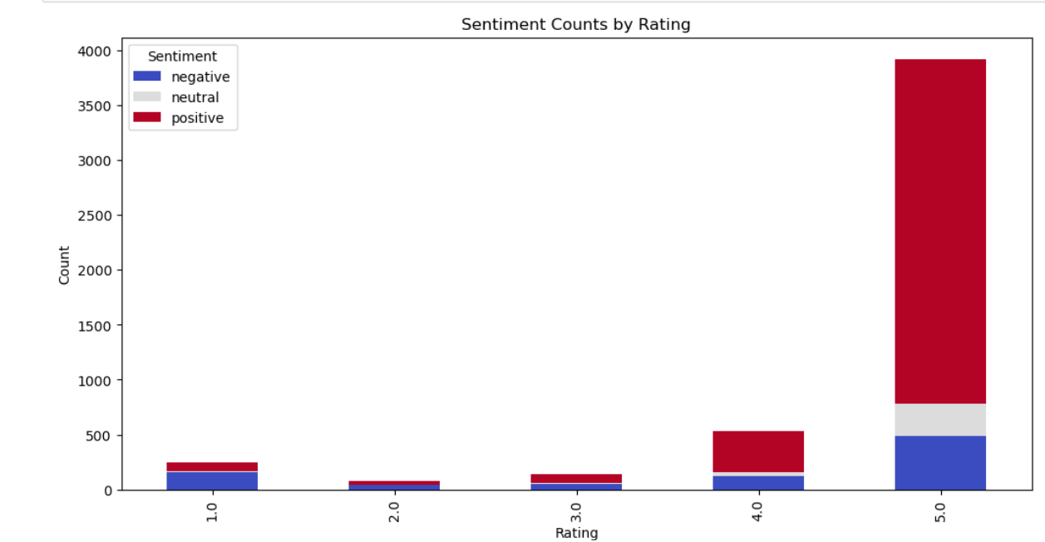
Some data visualizations

Slide 10
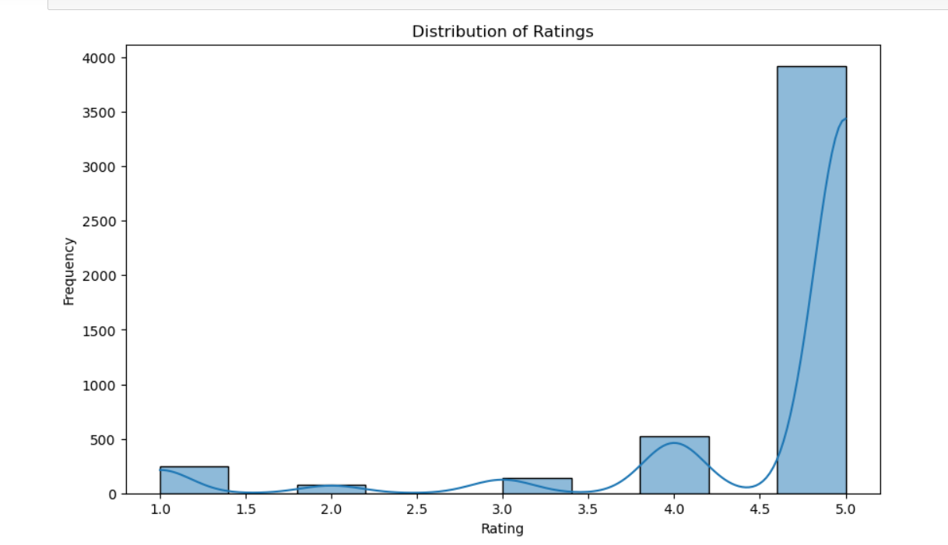
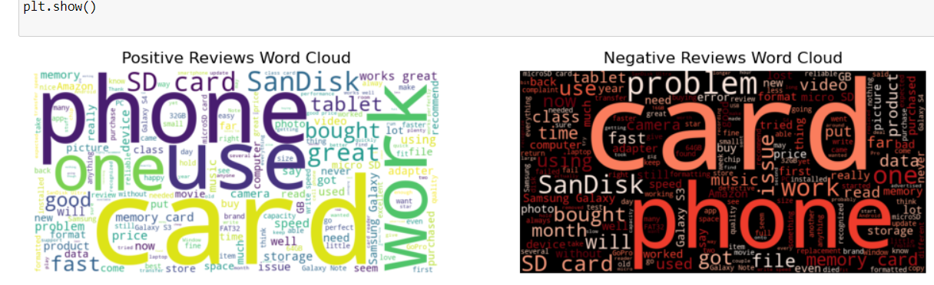
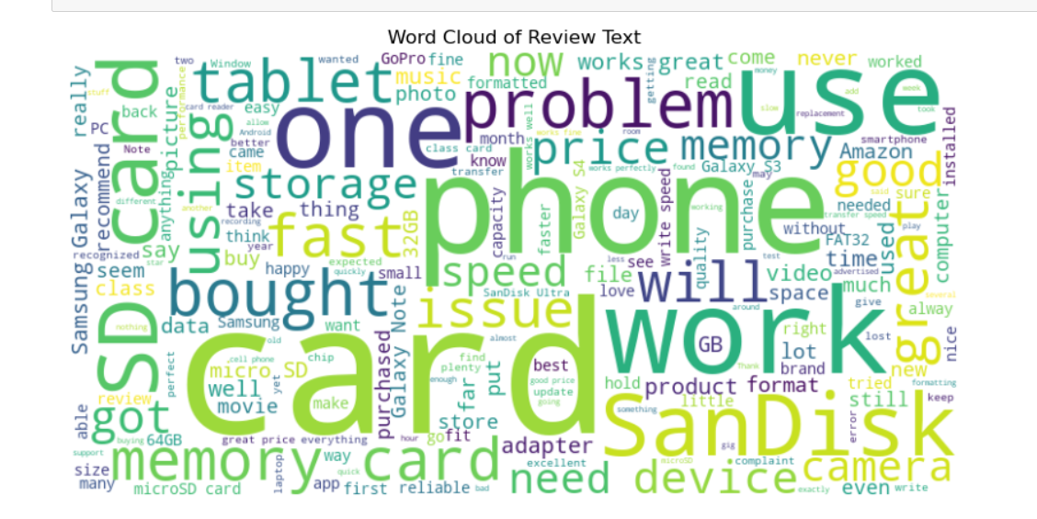
Some data visualizations

Slide 11
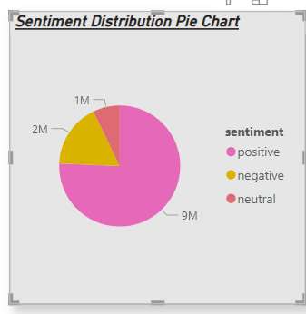
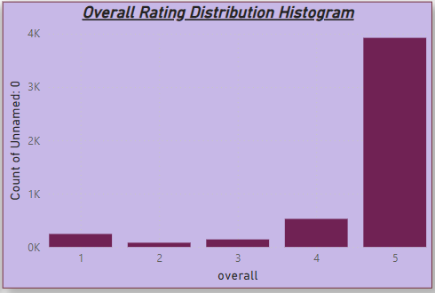
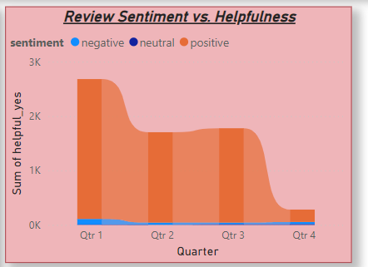
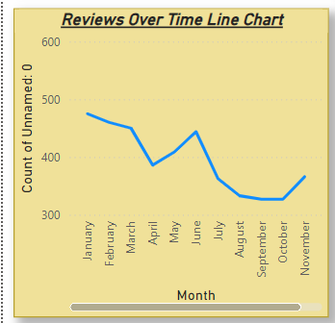
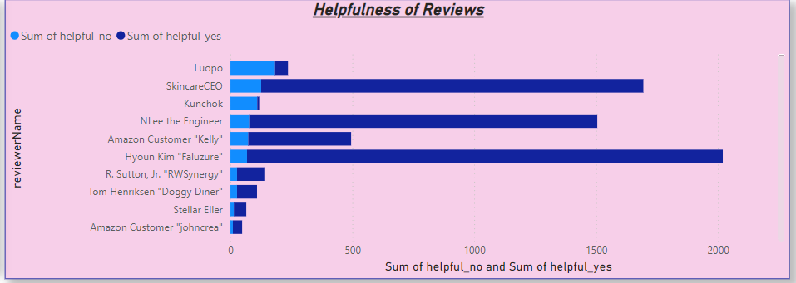
Data presentation (PowerBI Dashboards, results)

Slide 12

Github Link of the project
https://github.com/sgollapalli9/AIDI1006-200521939

Slide 13

Creativity – Solution Scope and Design
Objective and Scope:
Develop a sentiment analysis system to classify Amazon reviews into positive, negative, or neutral sentiments and generate actionable insights through visualization.
Data Preparation:
Load and clean review data by handling missing values, preprocessing text, and ensuring consistency for analysis.
Sentiment Analysis:
Use VADER sentiment analysis to categorize reviews and apply a function to classify sentiment based on polarity scores.
Feature Extraction and Model Training:
Convert text data into numerical features with TfidfVectorizer, train a Naive Bayes classifier, and evaluate model performance using accuracy and confusion matrix.
Visualization and Reporting:
Create visualizations like word clouds, distribution charts, and pie charts to illustrate sentiment distribution, and save the sentiment-labeled data and performance metrics for reporting.

Slide 14

Conclusion
The sentiment analysis project successfully transformed Amazon review data into actionable insights.
By leveraging text preprocessing techniques and sentiment analysis with VADER, the system effectively categorized reviews into positive, negative, or neutral sentiments.
The use of `TfidfVectorizer` and a Naive Bayes classifier enabled robust feature extraction and model training, yielding valuable metrics and performance evaluations.
Visualizations, including word clouds and sentiment distribution charts, provided clear and compelling insights into the sentiment trends within the reviews.
This comprehensive approach not only enhanced understanding of customer feedback but also paved the way for more data-driven decision-making and reporting.

Slide 15

Project References
Kaggle Website: https://www.kaggle.com/datasets/tarkkaanko/amazon
https://pandas.pydata.org/pandas-docs/stable/
https://scikit-learn.org/stable/user_guide.html
https://www.nltk.org/

Slide 16

Thank you

